Slide 1


Slide 2


Where you can get the “stuff” you need that isn’t food!

Slide 3
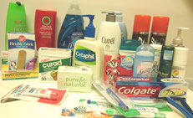
We help families in need with personal essentials
toilet paper
shampoo, conditioner
diapers, baby wipes
deodorant
toothbrushes & toothpaste
laundry detergent
dish soap
tampons, sanitary pads
razors, shaving cream

Slide 4
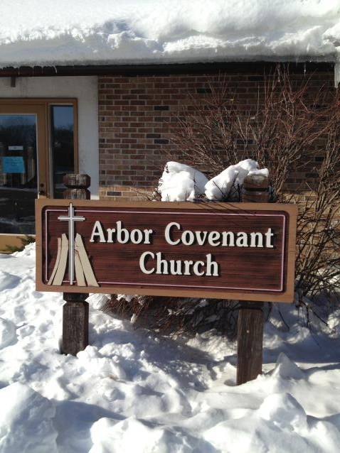
The Pantry is located at
2509 McDivitt St. in the Leopold/Arbor Neighborhood in Fitchburg, WI

Slide 5
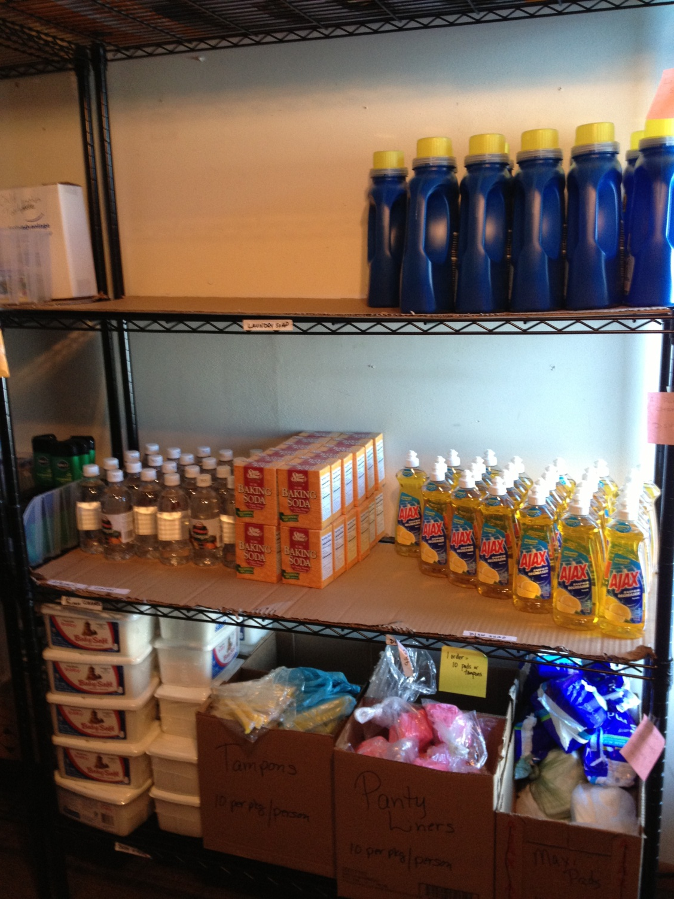
Volunteers unload and stock product on Thursday

Slide 6
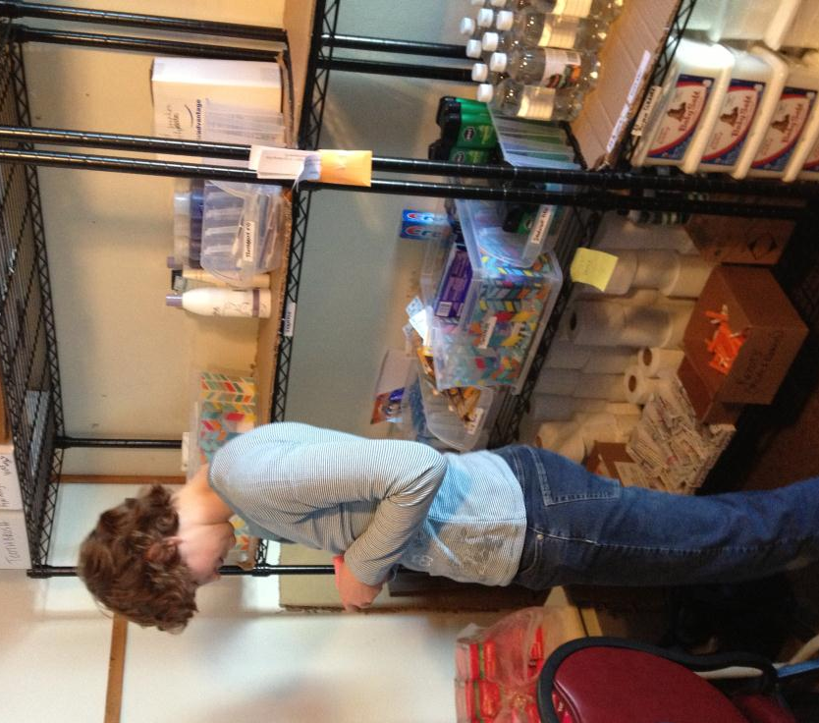
Volunteers package donations into correct portion sizes.
Kaitlin from Memorial UCC

Slide 7
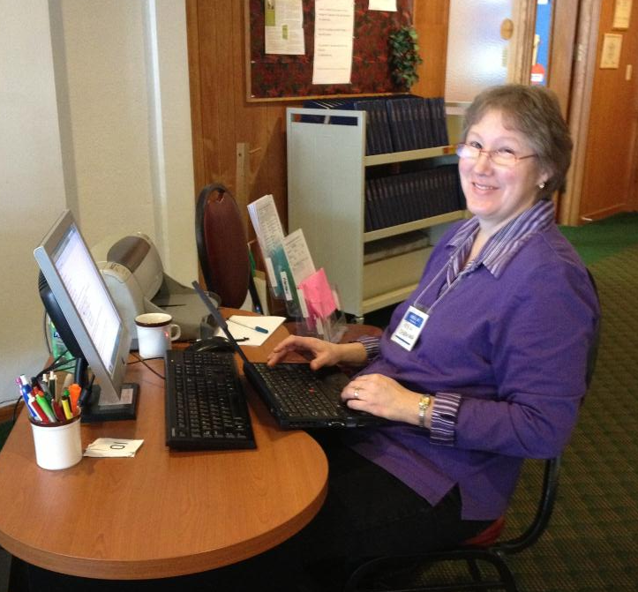
PANTRY DAY
We are open
Friday
10 am – 1 pm
&
3rd Thursdays
5:30 - 7:30 pm
Robin Cherwinka,
co-coordinator,
All Saints Lutheran

Slide 8
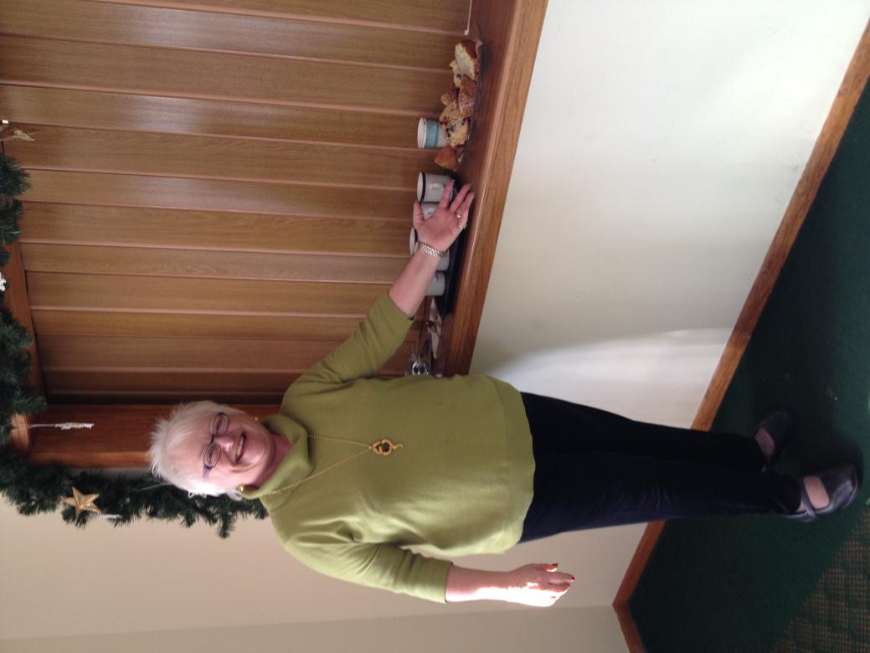
Jan Gietzel, from
Arbor Covenant, welcomes all!

Slide 9
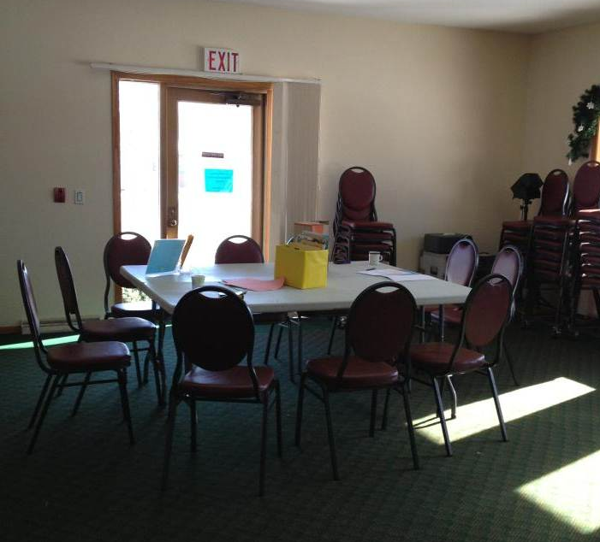
Guests are invited to relax & enjoy a cup of coffee while waiting for their supplies.

Slide 10
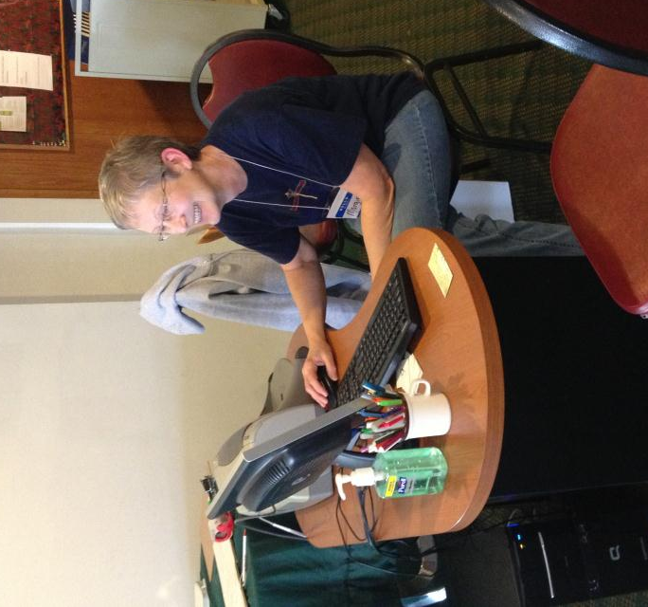
Margie Rem, volunteer, training to be a host on pantry day.
Hosts register guests

Slide 11
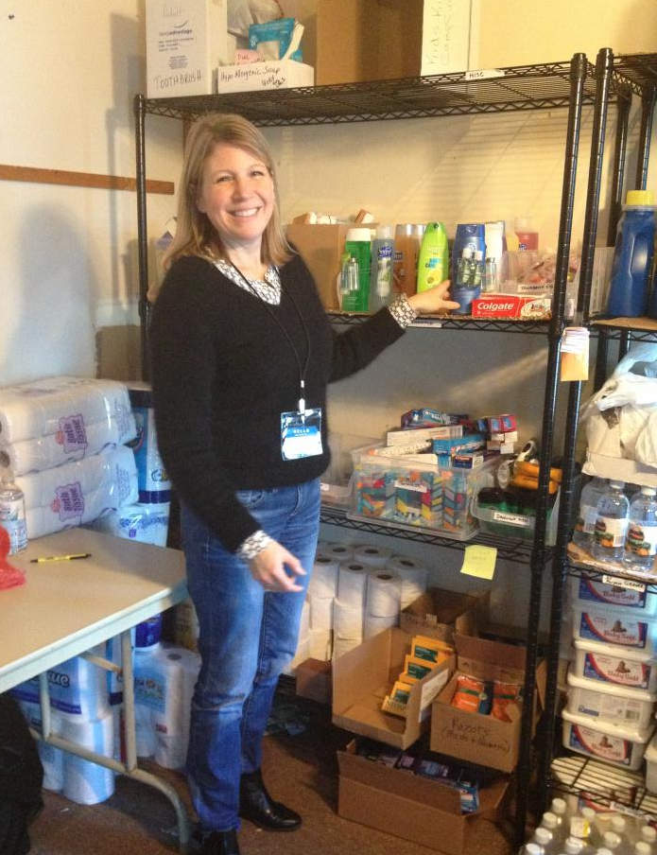
Volunteers fill guest orders
Lisa Fruit,
Memorial UCC

Slide 12
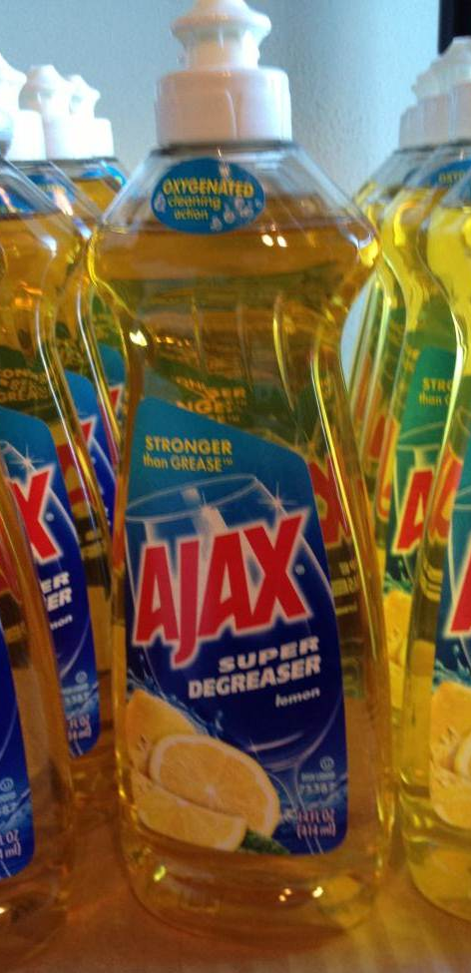
We partner with PEPartnership Alliance
They provide the software we use & place wholesale orders for us.

Slide 13
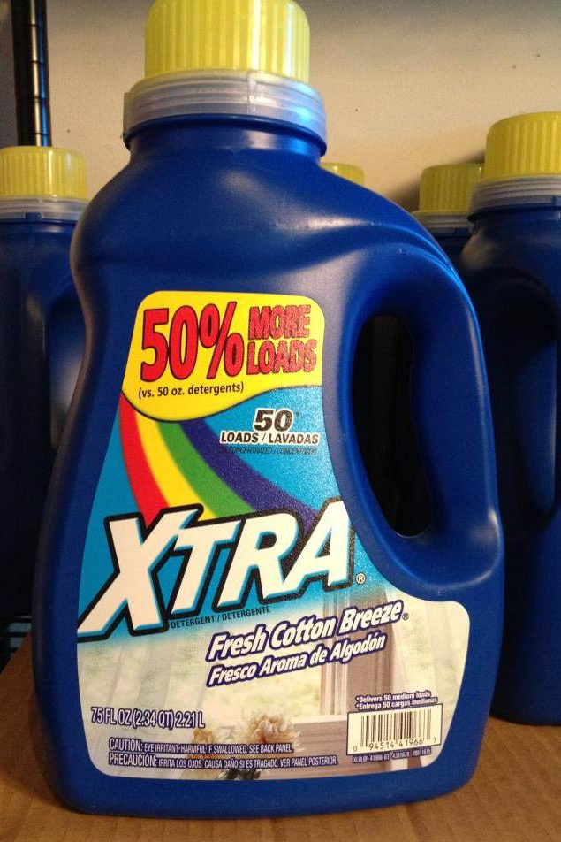
Cost: $1-$3 when we order wholesale.

Slide 14
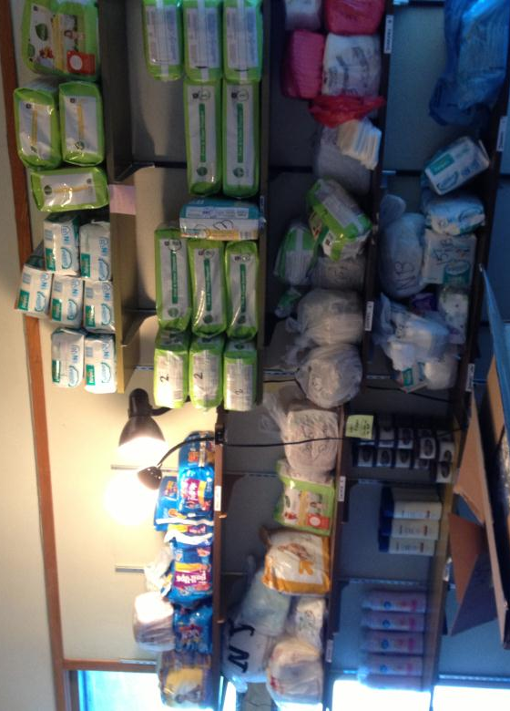
Diapers and pull ups of all sizes are always needed!

Slide 15
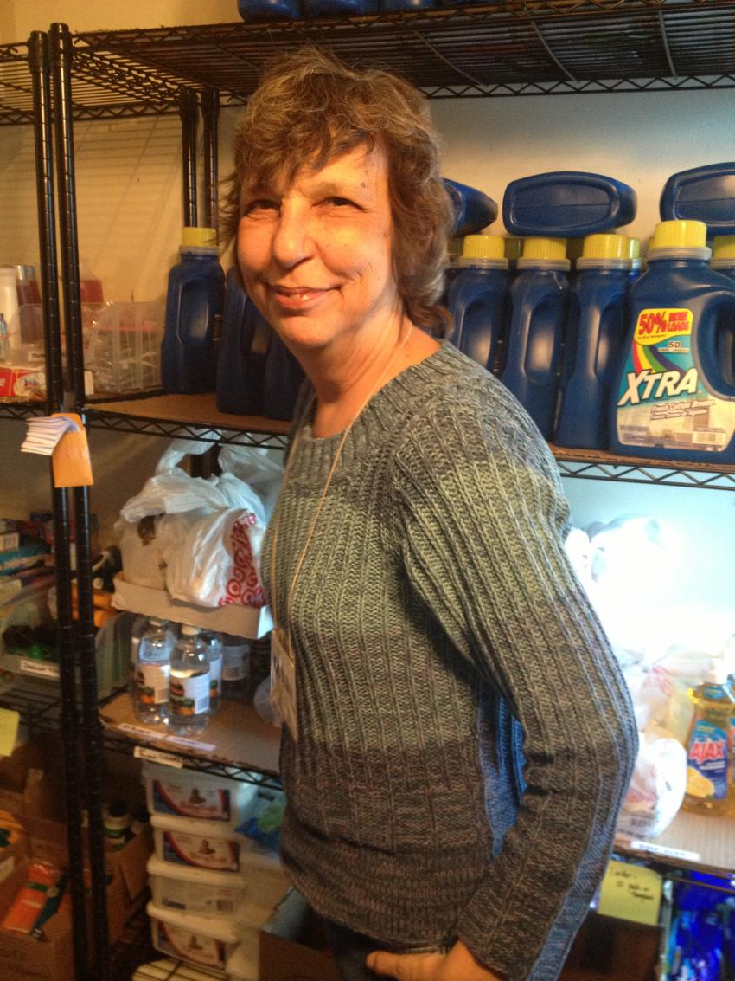
We offer effective &
“better for us” cleaning.
All purpose cleaner
is a mixture of vinegar, baking soda, & water.
Anna Curkeet,
of Fitchburg Christian Fellowship.

Slide 16

We are supported by area churches:
Arbor Covenant
All Saints Lutheran
Memorial United Church
of Christ
Fitchburg Christian
Fellowship
The Church at Christ Memorial

Slide 17
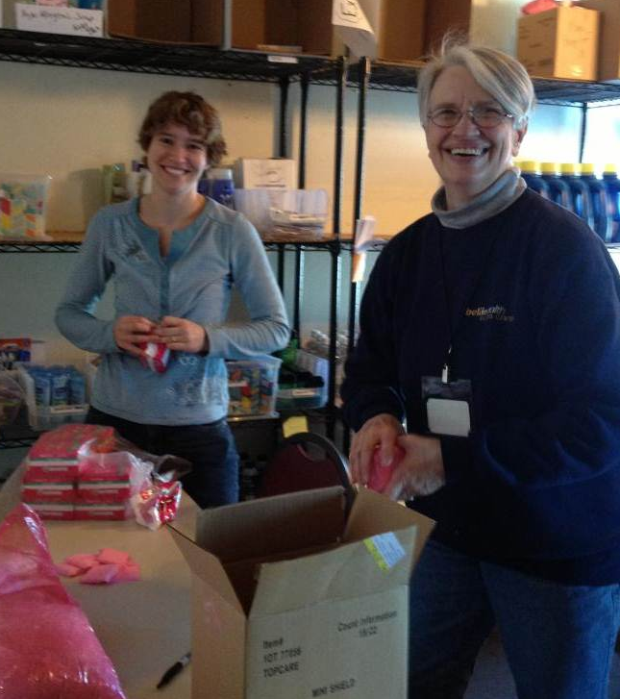
We schedule by phone, email or through Volunteerspot.com
Sign up to Volunteer!

Slide 18
Volunteer online at: www.GNPEP.net

Slide 19
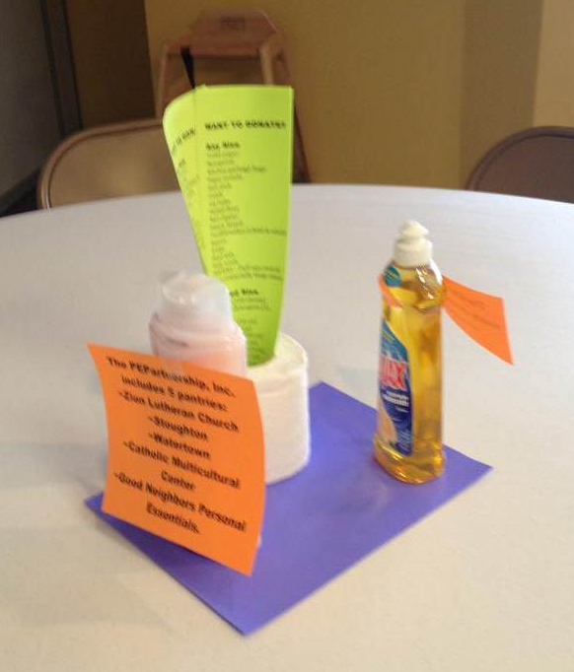
You can Help!
Promote the pantry at your church or workplace.

Slide 20
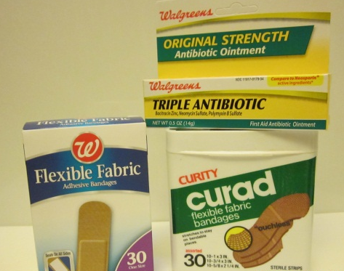
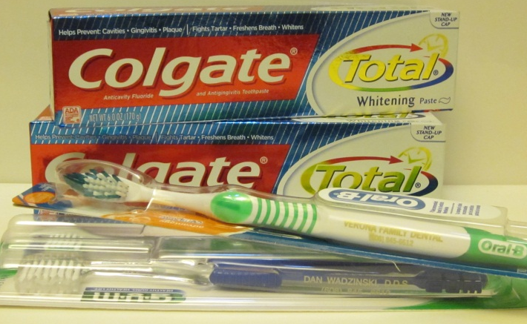
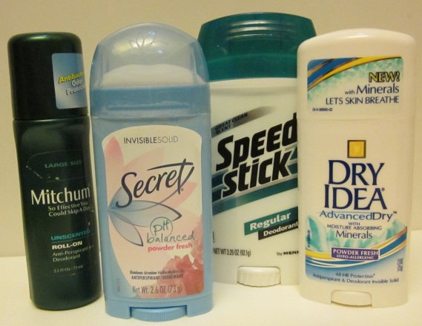
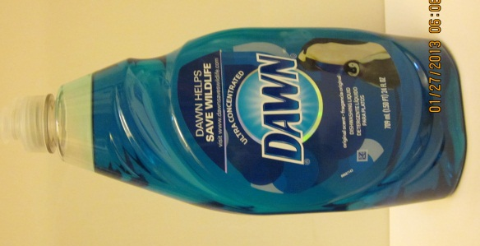
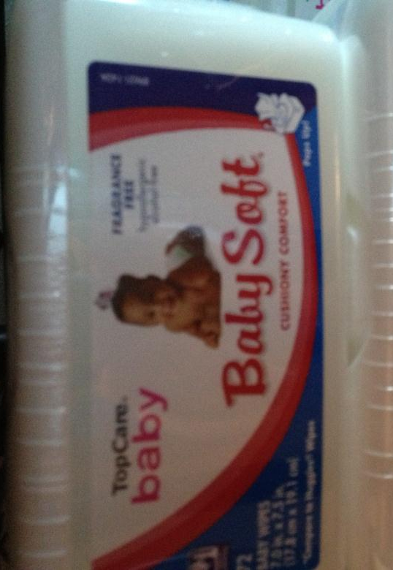
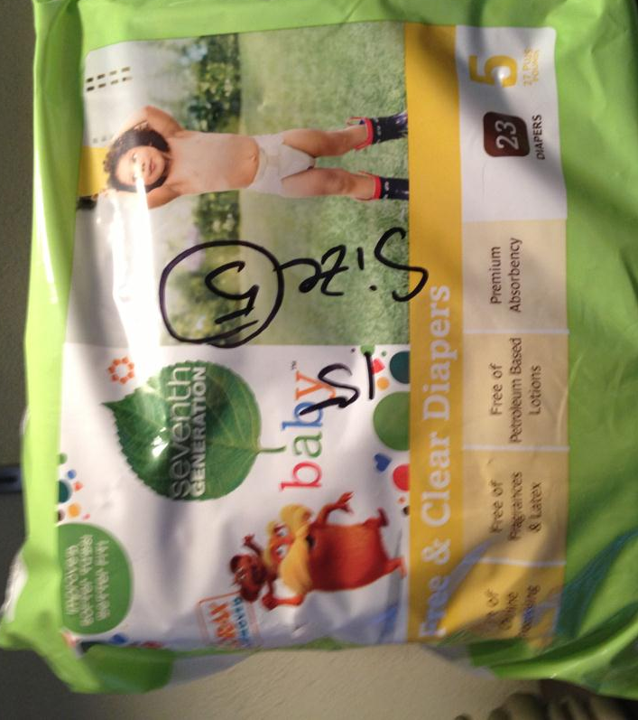
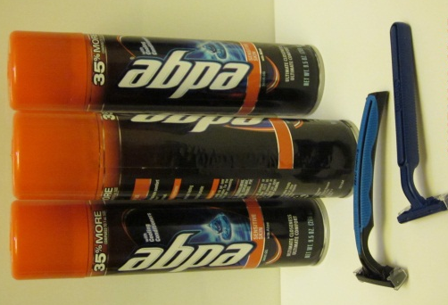
Organize a product drive for our most needed items!

Slide 21
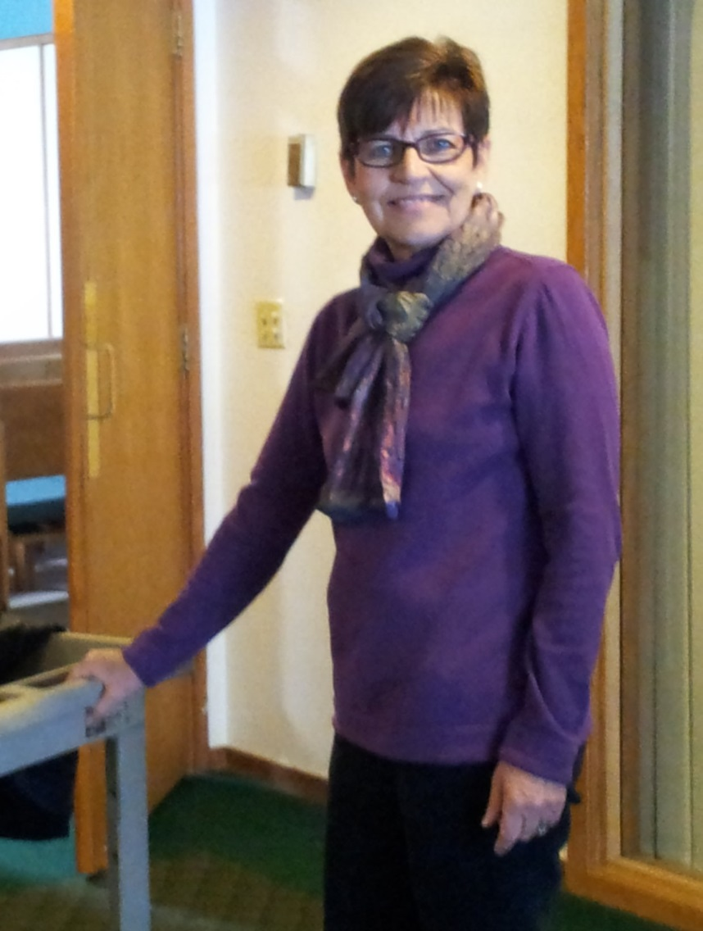
Brochures, handouts
& flyers are available to help spread the news.
Contact a coordinator to get started today!
Nancy Baumgartner,
co-coordinator,
Memorial United Church of Christ

Slide 22
For more information go to: www.GNPEP.net

